Slide 1
CSC 3210 Computer Organization and Programming
Chapter 2: x86 Processor
Architecture
Dr. Zulkar Nine
mnine@gsu.edu
Georgia State University
Spring 2021

Slide 2
X86 Processor Architecture
One step before using assembly language
What is the selected processor Internal architecture and capabilities.
What is the underline hardware associated with X86?
Assembly language is a great tool for learning how a computer works.
It require you to have working knowledge of computer hardware
You should have some basic knowledge about the processor and the system architecture in order to effectively program in the assembly language.

Slide 3
Outline
General Concepts
IA-32 Processor Architecture
IA-32 Memory Management
64-bit Processors
Components of an IA-32 Microcomputer
Input-Output System

Slide 4
General Concepts
Basic microcomputer design
Instruction execution cycle
Reading from memory
How programs run

Slide 5
General Concepts: Basic Microcomputer Design
ALU performs arithmetic and logical (bitwise) operations
Control unit (CU) coordinates sequence of execution steps
Clock synchronizes CPU operations with other system components
Data bus
Central Processing Unit (CPU)
Memory Storage Unit
I/O
Device
#1
I/O
Device
#1
Register
ALU
CU
clock
Control bus
Address bus

Slide 6
General Concepts: Basic Microcomputer Design
A bus: a group of parallel wires that transfer data
bus types:
address
data
control

Slide 7
General Concepts: Basic Microcomputer Design
The Address bus holds the addresses of instructions and data, when the currently executing instruction transfers data between the CPU and memory.
The Data bus transfers instructions and data between the CPU and memory.
The Control bus uses binary signals to synchronize actions of all devices attached to the system bus.

Slide 8
General Concepts: Clock
The system clock provides a timing signal to synchronize the operations of the system.
Synchronizes all CPU and BUS operations
A clock is a sequence of 1’s and 0’s
The frequency:
is the number of cycles that happens each second
Notes:
TH, 9:30, Sep 31

Slide 9
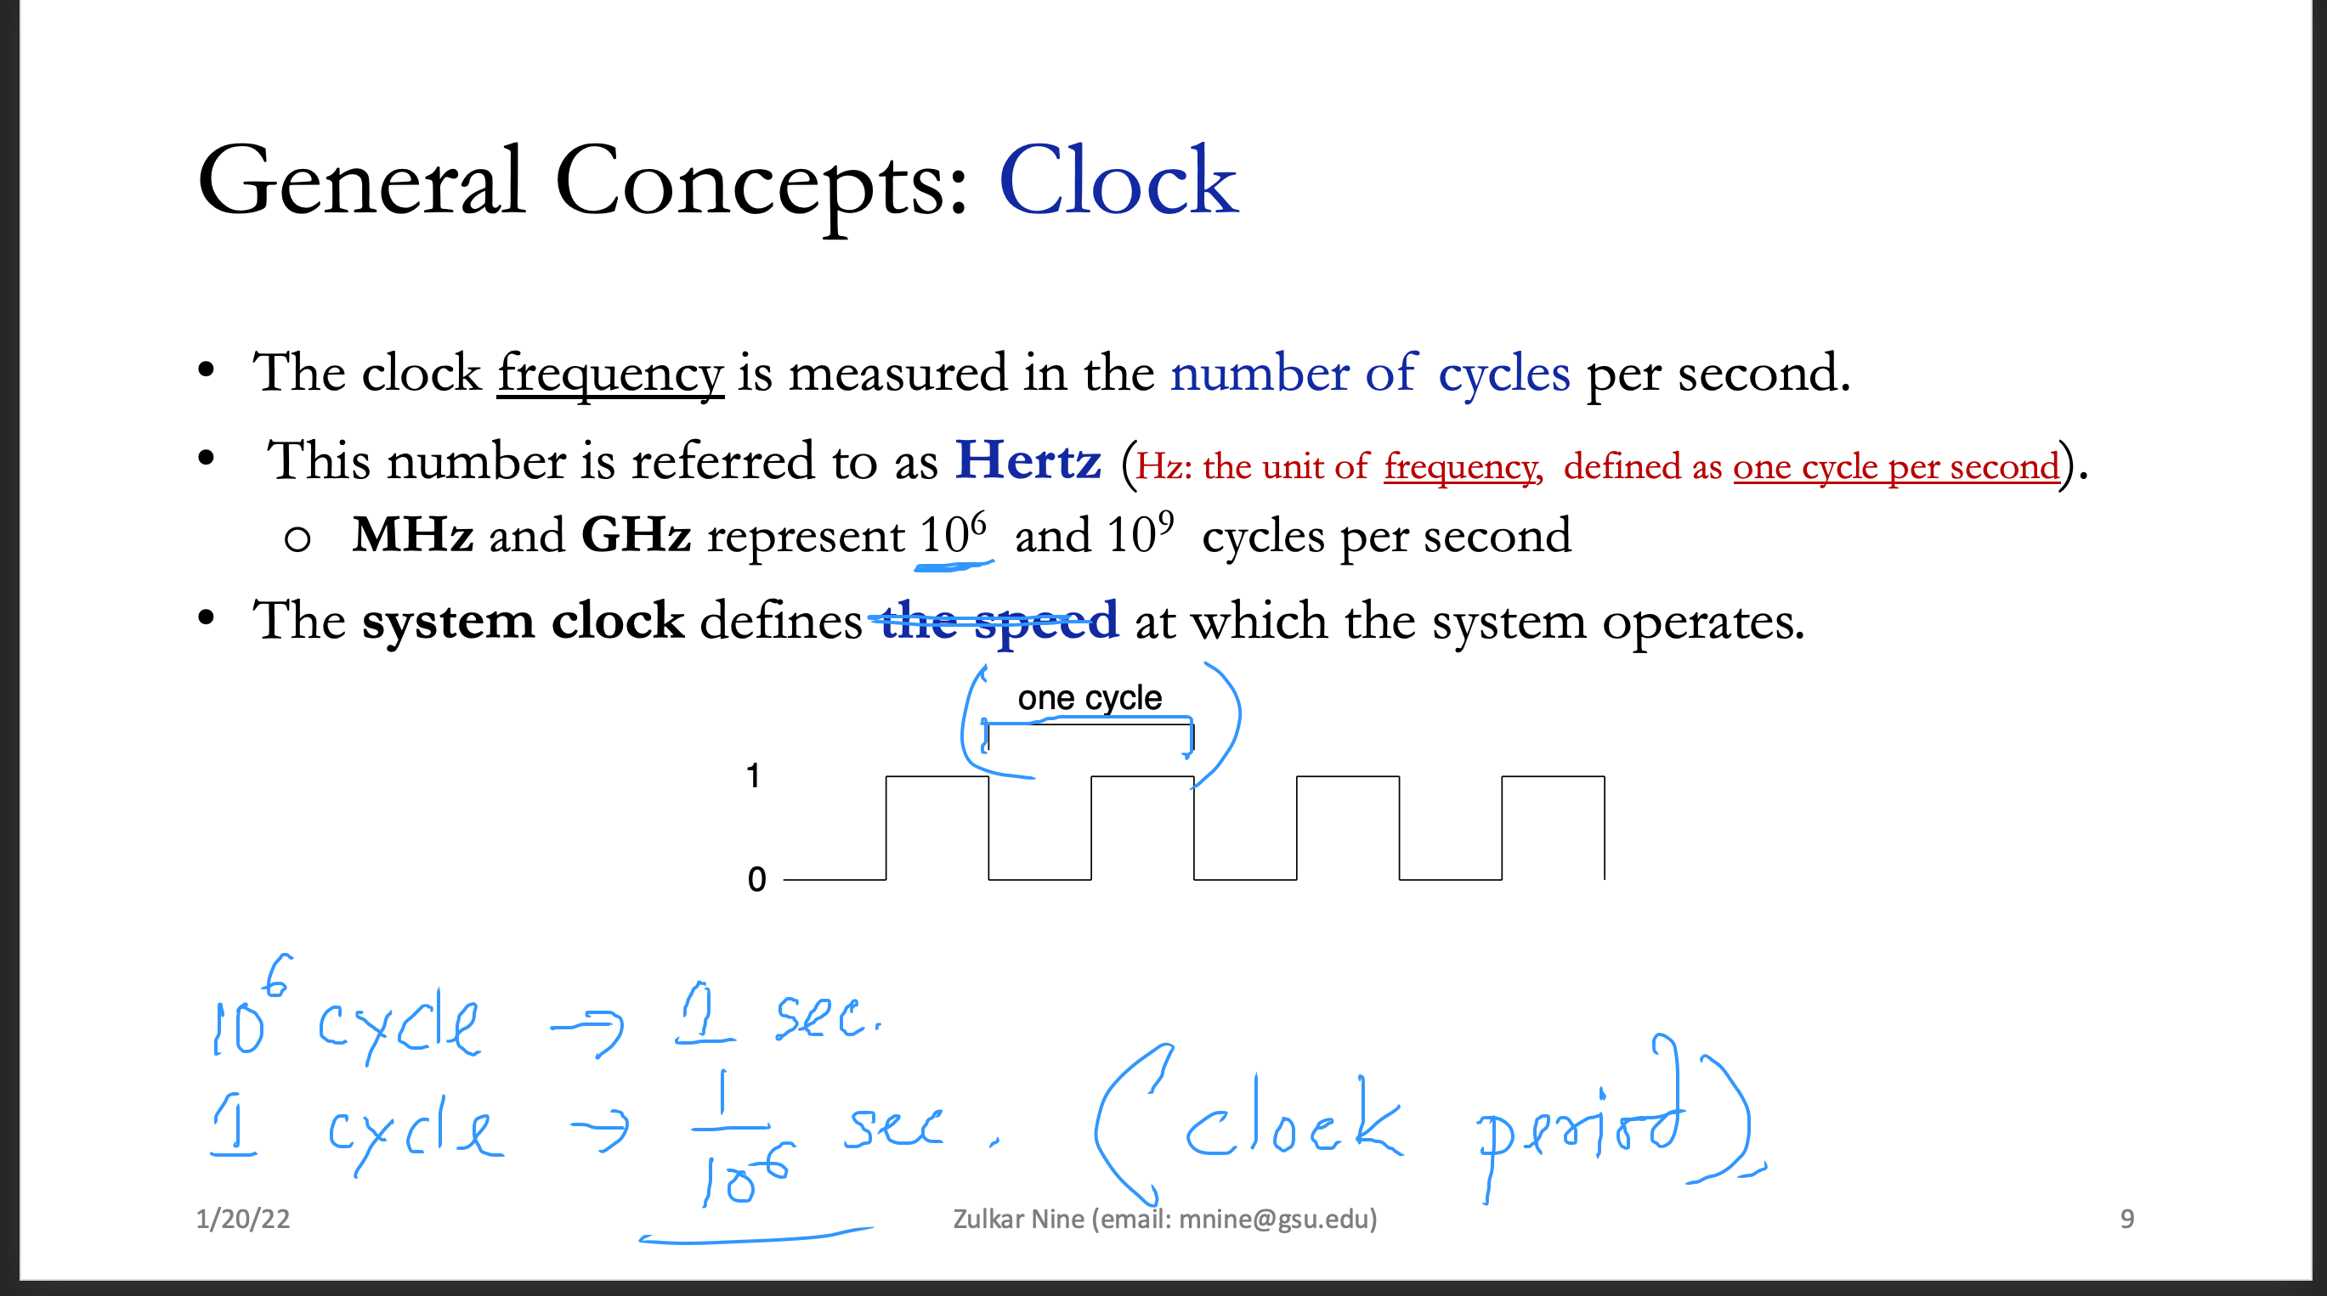
General Concepts: Clock
The clock frequency is measured in the number of cycles per second.
This number is referred to as Hertz (Hz: the unit of frequency, defined as one cycle per second).
MHz and GHz represent 10⁶ and 10⁹ cycles per second
The system clock defines the speed at which the system operates.

Slide 11
General Concepts: Clock
Ex: transfer of data from a memory location to X86 (Pentium) takes three clock cycles.
The clock period is defined as the length of time taken by one clock cycle .
If it takes three clock cycles to execute an instruction, it takes 3 X 1 ns = 3 ns.
Machine (clock) cycle measures time of a single operation
Clock is used to trigger events

Slide 12
General Concepts: Clock
A machine instruction requires one clock cycle to execute, few require 50 clocks
Instructions require memory access: Empty clock cycle, wait states, Why?
CPU, system bus, and memory circuits
Notes:
Wed, 30th Aug

Slide 13
Clock per Instruction (CPI)
Is an effective average.
It is the average number of clocks required by the instructions in a program.
In a program 60% instructions takes 4 clock cycles and the rest of the instructions takes 1 clock cycles.
CPI = 0.6 * 4 + 0.4 * 1 = 2.8 clocks per instruction.

Slide 14
Million Instructions Per Second
Step 1: Perform Divide operation between no. of instructions and Execution time.
Step 2: Perform Divide operation between that variable and 1 million for finding millions of instructions per second.
For example,
if a computer completed 2 million instructions in 0.10 seconds
2 million/0.10 = 20 million.
No of MISP=20 million/1 million
=20

Slide 15
An Example
An instruction on average takes 4 clock cycles to execute. A program with these instructions take 5 seconds to run on a 1.2 GHz processor. How many instructions the program have?

Slide 16
General Concepts
Basic microcomputer design
Instruction execution cycle
Reading from memory
How programs run

Slide 17
Instruction Execution Cycle
An instruction is a binary pattern designed inside a microprocessor to perform a specific function.
The entire group of instructions that a microprocessor supports is called Instruction Set.
8086 has more than 20,000 instructions.
Classification of Instruction Set
Data Transfer Instructions: mov, push, pop,…
Arithmetic Instructions: add, sub, inc …
Bit Manipulation Instructions: and, or, xor, ….
Program Execution Transfer Instructions: jmp, call, ret, ….
String Instructions: cmps, movs, rep, …
Processor Control Instructions: stc, clc, wait…

Slide 18
Instruction Execution Cycle
Instruction format
An instruction consists of an opcode, usually with some additional information like where operands come from, and where results go.
Operation Code
add
Operation Code | Operand 1
add a
Operation Code | Operand 1 | Operand 2
add R0,R1
Operation Code | Operand 1 | Operand 2 | Operand 2
add R0,R1,R2
An operand can be register, memory location or immediate (ex. mov 5,R0) operand

Slide 19
Instruction Execution Cycle
Predefined sequence of steps to execute a machine
instruction
Simple IEC: Fetch, Decode, Execute
Fetch
Decode
Fetch operands (not always needed?)
Address calculation?
Execute
Update few status flags: zero, carry, overflow
Store output (not always needed?)
Control bus?
Notes:
Thursday, 31, 4 pm

Slide 20
General Concepts
Basic microcomputer design
Instruction execution cycle
Reading from memory
How programs run

Slide 21
Memory
The memory unit supports two fundamental operations: read and write .
The read operation reads a previously stored data
The write operation stores a value in memory.
Both of these operations require an address in memory from which to read a value or to which to write a value.

Slide 22
Memory
Memory (RAM) as an array of bytes

Slide 23
Memory
write operation requires specification of the data to be written.
The read and write signals come from the control bus.

Slide 24
Memory: Reading from Memory
Multiple machine cycle are required when reading from memory, Why?
Because it responds much more slowly than the CPU.
Steps in a typical read cycle
Place the address of the value you want to read on the address bus.
Assert (changing the value of) the processor’s RD (read) pin.
Wait one clock cycle for the memory chips to respond.
Copy the data from the data bus into the destination operand

Slide 25
Memory: Writing to Memory
Steps in a typical write cycle:
Place the address of the location to be written on the address bus,
Place the data to be written on the data bus,
Assert (changing the value of) the processor’s WR (write) pin.
Wait for the memory to store the data at the addressed location

Slide 26
Reading from Memory: Cache Memory
In practice, instructions and data are not fetched, most of the time, from the main memory.
There is a high-speed cache memory that provides
faster access to instructions and data than the main memory.

Slide 28
Reading from Memory: Cache Memory
Level-1 cache: inside the CPU
Level-2 cache: outside the CPU (attached to CPU by high speed data bus)

Slide 29
Reading from Memory: Cache Memory
Cache hit: when data to be read is already in cache memory
Cache miss: when data to be read is not in cache memory.

Slide 30
General Concepts
Basic microcomputer design
Instruction execution cycle
Reading from memory
How programs run

Slide 31
How a Program Runs
Program loaded:
Hard disk drive
loader
RAM
OS points to program entry point
CPU

Slide 32
Think Again?
Why does memory access take more machine cycles than register access?
What are the three basic steps in the instruction execution cycle?
Which two additional steps are required in the instruction execution cycle when a memory operand is used?

Slide 33
Outline
General Concepts
IA-32 Processor Architecture
IA-32 Memory Management
64-bit Processors
Components of an IA-32 Microcomputer
Input-Output System

Slide 34
Basic Execution Environment
Addressable memory
General-purpose registers
Index and base registers
Specialized register uses
Status flags
Floating-point, MMX, XMM registers
Notes:
Sep 6, W, 3p

Slide 35
Basic Execution Environment: Addressable Memory
Address Space
Protected mode
4 GB space
32-bit address
Real-address and Virtual-8086 modes
1 MB space
20-bit address

Slide 36
Basic Execution Environment: General-Purpose Registers
Registers are high speed storage locations inside the CPU.
E for Extended?
Ax Accumulator
BX Bas
CX Counter
DX Data
Base Pointer
Stack Pointer
Source Index
Destination Index
Instruction Pointer
Notes:
http://www.swansontec.com/sregisters.html
EAX - All major calculations take place in EAX, making it similar to a dedicated accumulator register.
EDX - The data register is the an extension to the accumulator. It is most useful for storing data related to the accumulator's current calculation.
ECX - Like the variable i in high-level languages, the count register is the universal loop counter.
EDI - Every loop must store its result somewhere, and the destination index points to that place. With a single-byte STOS instruction to write data out of the accumulator, this register makes data operations much more size-efficient.
ESI - In loops that process data, the source index holds the location of the input data stream. Like the destination index, EDI has a convenient one-byte instruction for loading data out of memory into the accumulator.
ESP - ESP is the sacred stack pointer. With the important PUSH, POP, CALL, and RET instructions requiring it's value, there is never a good reason to use the stack pointer for anything else.
EBP - In functions that store parameters or variables on the stack, the base pointer holds the location of the current stack frame. In other situations, however, EBP is a free data-storage register.
EBX - In 16-bit mode, the base register was useful as a pointer. Now it is completely free for extra storage space.

Slide 37
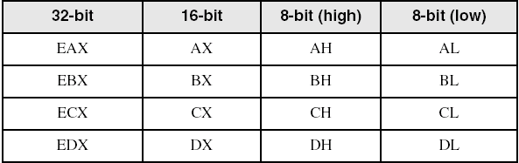
Basic Execution Environment: Accessing Parts of Registers
Use 8-bit name, 16-bit name, or 32-bit name
Applies to EAX, EBX, ECX, and EDX
Ex:
Notes:
Tuesday, June, 13th

Slide 39
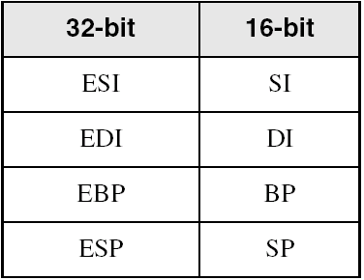
Basic Execution Environment: Index and Base Registers
Some registers have only a 16-bit name for their lower half:

Slide 40
Basic Execution Environment: Some Specialized Register Uses
General-Purpose
EAX – accumulator: automatically used by multiplication and division instructions
ECX – loop counter: contain the loop count value for iterative instructions
ESI, EDI – index registers: used by high-speed memory transfer instructions.

Slide 41
Basic Execution Environment: Some Specialized Register Uses
General-Purpose
ESP – stack pointer: addresses data on the stack, rarely used for ordinary arithmetic or data transfer.
EBP – frame pointer (stack): used by high-level languages to reference function parameters and local variables on the stack.
Notes:
TUH, 4pm, sep5

Slide 42
Basic Execution Environment: Some Specialized Register Uses
Segment:
Indicate base addresses of preassigned memory areas.
The six segment registers point to where these segments are located in the memory.
CS – code segment: hold program instructions
DS – data segment: hold variables
SS – stack segment: holds local function variables and function parameters.
ES, FS, GS - additional segments: can be used in a similar way as the other segment registers.
support the segmented memory organization

Slide 43
Basic Execution Environment: Some Specialized Register Uses
ES, FS, GS - additional segments
For example,
If a program’s data could not fit into a single data segment, we could use two segment registers to
point to the two data segments.

Slide 44
Basic Execution Environment: Some Specialized Register Uses
EIP – instruction pointer (also called program counter): contains the address of the next instruction to be executed .
EFLAGS- a register consists of individual binary bits that control the operation of the CPU or reflect the outcome of some CPU operation.
status and control flags
Each flag is a single binary bit
A flag is set when it equals 1; it is clear (or reset) when it equals 0.

Slide 45
Flags Table

Slide 46
Basic Execution Environment: Status Flags
Status flags record certain information about the most recent arithmetic or logical operation.
Carry
unsigned arithmetic out of range
Overflow
signed arithmetic out of range
Sign
result is negative
Zero
result is zero
Auxiliary Carry
carry from bit 3 to bit 4
Parity
sum of 1 bits is an even number

Slide 47
Basic Execution Environment: Some Specialized Register Uses
General-Purpose (Note)
Despite their designation as general-purpose registers, there restrictions on how they can be used.
Many instructions either require or implicitly use specific registers as operands.
Ex:
Some variations of the imul (Signed Multiply) and idiv (Signed Divide) instructions use the EDX register to hold the high-order doubleword of a product or dividend.
The string instructions require that the addresses of the source and destination operands be placed in the ESI and EDI registers, respectively.

Slide 48
Basic Execution Environment: Some Specialized Register Uses
General-Purpose
The processor uses the ESP register to support stack-related operations such as function calls and returns.
Register EBP is typically used as a base pointer to access data items that are stored on the stack
Given the limited number general-purpose registers available in x86,
It is frequently necessary to use a general-purpose register in a non-conventional manner.
x86 assemblers do not enforce these usage conventions.

Slide 50
Basic Execution Environment: MMX, XMM, Floating-Point Registers
Eight 64-bit MMX registers: MMX instructions operates on parallel
Eight 128-bit XMM registers for single-instruction multiple-data (SIMD) operations
Floating-Point: Eight 80-bit floating-point data registers
ST(0), ST(1), . . . , ST(7)
arranged in a stack
used for all floating-point arithmetic

Slide 51
Outline
General Concepts
IA-32 Processor Architecture
IA-32 Memory Management
64-bit Processors
Components of an IA-32 Microcomputer
Input-Output System
Notes:
TTH, 9:30, Sep7

Slide 52
IA-32 Memory Management
Real-address mode
Protected mode
Virtual-8086

Slide 53
Real-address Mode
Only 1 M Byte of memory can be addressed,
The processor can run only one program at a time,
but it can momentarily interrupt that program to process requests (called interrupts) from peripherals.
Application programs are permitted to access any memory location,
including addresses that are linked directly to system hardware.
The MS-DOS operating system runs in real-address mode, and Windows 95 and 98 can be booted into this mode.

Slide 54
Protected Mode
The processor can run multiple programs at the same time.
It assigns each process (running program) a total of 4 GByte of memory.
Each program can be assigned its own reserved memory area,
and programs are prevented from accidentally accessing each other’s code and data.
MS-Windows and Linux run in protected mode.

Slide 55
Virtual-8086 Mode
The computer runs in protected mode and creates a virtual-8086 machine with 1-MByte address space
simulates an 80x86 computer running in real address mode.
Windows NT and 2000, create a virtual-8086 machine when you open a Command window.
You can run many such windows at the same time, and each is protected from the actions of the others.
Some MS-DOS programs that make direct references to computer hardware will not run in this mode under Windows NT, 2000, and XP.

Slide 56
Think Again?
2. Name all eight 32-bit general-purpose registers.
3. Name all six segment registers.
4. What special purpose does the ECX register serve?

Slide 57
Outline
General Concepts
IA-32 Processor Architecture
IA-32 Memory Management
64-bit Processors
Components of an IA-32 Microcomputer
Input-Output System

Slide 58
64-Bit Processors
64-Bit Operation Modes
Compatibility mode – can run existing 16-bit and 32-bit applications (Windows supports only 32-bit apps in this mode)
64-bit mode – Windows 64 uses this
Basic Execution Environment
addresses can be 64 bits (48 bits, in practice)
16 64-bit general purpose registers
64-bit instruction pointer named RIP
Notes:
TTH, 4pm,sep 7

Slide 59
64-Bit Processors: 64-Bit General Purpose Registers
32-bit general purpose registers:
EAX, EBX, ECX, EDX, EDI, ESI, EBP, ESP, R8D, R9D, R10D, R11D, R12D, R13D, R14D, R15D
64-bit general purpose registers:
RAX, RBX, RCX, RDX, RDI, RSI, RBP, RSP, R8, R9, R10, R11, R12, R13, R14, R15

Slide 60
Outline
General Concepts
IA-32 Processor Architecture
IA-32 Memory Management
64-bit Processors
Components of an IA-32 Microcomputer
Input-Output System

Slide 61
Components of an IA-32 Microcomputer
Motherboard
Video output
Memory
Input-output ports

Slide 62
Motherboard
CPU socket
External cache memory slots
Main memory slots
BIOS chips
Sound synthesizer chip (optional)
Video controller chip (optional)
IDE, parallel, serial, USB, video, keyboard, joystick, network, and mouse connectors
PCI bus connectors (expansion cards)

Slide 63
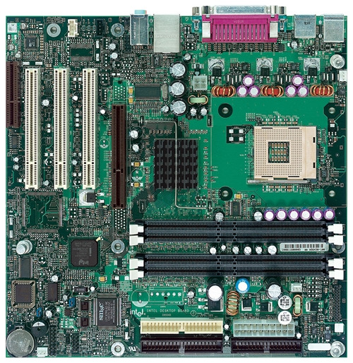
Intel D850MD Motherboard
mouse, keyboard, parallel, serial, and USB connectors
Video
4
Audio chip
PCI slots
memory controller hub
Pentium 4 socket
AGP slot
2
dynamic RAM
3
1
Firmware hub
I/O Controller
Speaker
Power connector
Battery
Diskette connector
IDE drive connectors
Notes:
Sec03 and 09 Thursday_26
Firmware:
permanent software programmed into a read-only memory.
software that provides control, monitoring and data manipulation of engineered products and systems. Typical examples of devices containing firmware are embedded systems (such as traffic lights, consumer appliances, remote controls and digital watches), computers, computer peripherals, mobile phones, and digital cameras. The firmware contained in these devices provides the low-level control program for the device. As of 2013, most firmware can be updated.^{[2]}

Slide 64
Outline
General Concepts
IA-32 Processor Architecture
IA-32 Memory Management
64-bit Processors
Components of an IA-32 Microcomputer
Input-Output System

Slide 65
Input-Output Systems

Slide 66
Input-Output Systems
Input/output (I/O) devices provide the means by which a computer system can interact with the outside world
An I/O device can be:
an input device (e.g., keyboard, mouse), or
an output device (e.g., printer, display screen), or
both an input and output device (e.g., disks)
Notes:
A Controller provides the necessary low-level commands and data for proper operation of the associated I/O device
Ex. Before the processor sends a character to be printed, it has to first check the status register of the associated
I/O controller to see whether the printer is online/offline, busy or idle, out of paper, and so
on.
The data register holds the character to be printed, and the command register tells the
controller the operation requested by the processor (for example, send the character in the
data register to the printer). The following summarizes the sequence of actions involved in
sending a character to the printer:
• Wait for the controller to finish the last command;
• Place a character to be printed in the data register;
• Set the command register to initiate the transfer.

Slide 67
Input-Output Systems
I/O devices are not directly connected to the system bus
I/O controller acts as an interface between the system and the I/O device.
I/O controller receives input and output requests from the central processor, and then send device-specific control signals to the device they control.
I/O controllers typically have three types of internal registers a data register, a status register, and a command register
Notes:
A Controller provides the necessary low-level commands and data for proper operation of the associated I/O device
Ex. Before the processor sends a character to be printed, it has to first check the status register of the associated
I/O controller to see whether the printer is online/offline, busy or idle, out of paper, and so
on.
The data register holds the character to be printed, and the command register tells the
controller the operation requested by the processor (for example, send the character in the
data register to the printer). The following summarizes the sequence of actions involved in
sending a character to the printer:
• Wait for the controller to finish the last command;
• Place a character to be printed in the data register;
• Set the command register to initiate the transfer.

Slide 68
Input-Output Systems: Level of I/O Access
Application programs read input from keyboard and disk files and write output to the
screen and to files.
I/O need not be accomplished by directly accessing hardware
You can call functions provided by the operating system.
I/O is available at different access levels, High-level language functions, Operating system, BIOS

Slide 69
Input-Output Systems: Level of I/O Access
Level 3: High-level language function
examples: C++, Java
contains functions to perform input–output
portable, convenient, not always the fastest
Level 2: Operating system
Application Programming Interface (API) (writing string to files, read string from keyboard, allocating block of memory)
extended capabilities, lots of details to master
Level 1: BIOS
Collection of low-level subroutines that communicate directly with hardware devices.
Installed by computer’s manufacturer
OS security may prevent application-level code from working at this level
Notes:
Wed, Sep 13.

Slide 70
Input-Output Systems: Displaying a String of Characters
When a HLL program displays a string of characters, the following steps take place:
- Statement calls library function
- Calls an operating system function
- Pass a string pointer
- Calls BIOS subroutine
- Passing ASCI and color for each
- Call another subroutine to move
cursor to next position
- Receives a character, maps it to a particular system font,
- Sends the character to a hardware port
- The Video controller card generates hardware signals to the video display

Slide 71
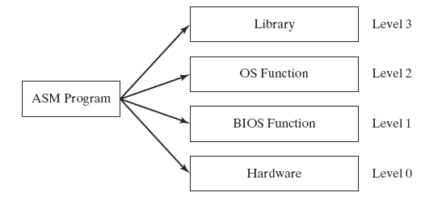
Input-Output Systems: Programming levels
Assembly language programs can perform input-output at each of the following levels:
- Call library functions to perform generic text I/O and file-based I/O
- Call operating system functions to perform generic text I/O and file-based I/O.
- Call BIOS functions to control device-specific features such as keyboard input, low-level disk I/O. etc.
Control vs. portability
- Send and receive data from hardware ports, having absolute control over specific devices.

Slide 72
Summary

